Slide 1

MAKING A HANGMAN GAME IN PYTHON + TURTLE GRAPHICS
Find the code at: https://github.com/FelixMilan/Hangman

Slide 2
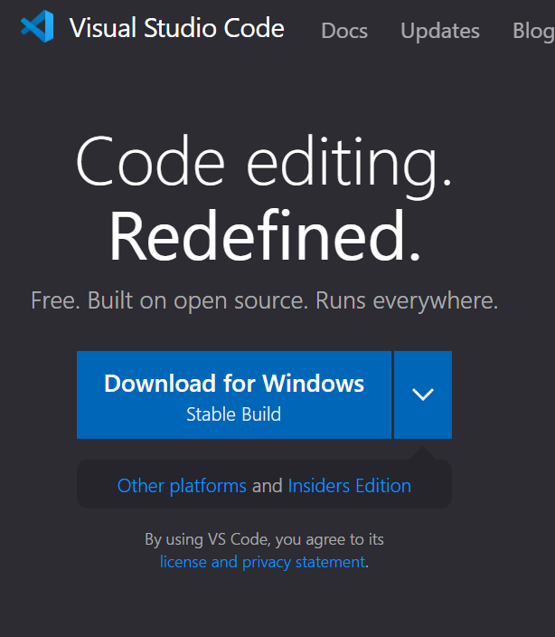

Using a good IDE
For this I will be using Visual Studio Code, a powerful IDE that allows me to write and test code at the same time.
It also has an inbuilt terminal so I can create all elements of this game from within one program.
The university computers already have Visual Studio Code installed but if you are using your own laptop you can install it here: https://code.visualstudio.com/

Slide 3
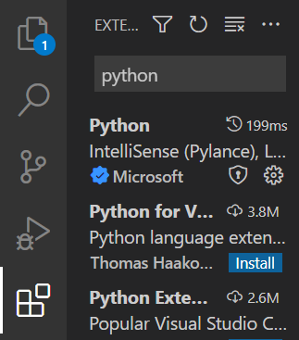
Install python plugin
You’ll need to install the python plug in to be able to debug and run our program.
Go to the top left of your Visual Studio page and click the icon of 4 blocks, search python, then install the plugin called “Python” by Microsoft.

Slide 4

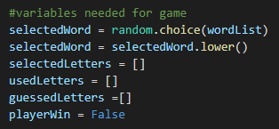
PART 1: Creating our variables and functions
Start by importing random at the top of our project. This forms the basis of our game as we need to use the random module. While we’re at it we’ll import turtle for later too.
Next we are going to create all our variables at the top of our code. By doing this we can keep them all neatly and view them in one place.
These will all be used later, selectedWord picks a random word from the word bank and then we make sure it’s all lower case.
selectedLetters is a list made from the letters in selectedWord.

Slide 5
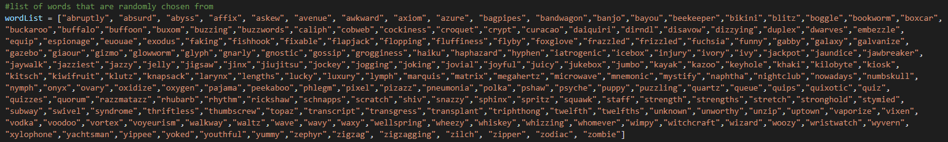
Adding our Word bank
I’ve made a bank of obscure words from the internet that you’re welcome to use. It’s in the README in the GitHub repo (https://github.com/FelixMilan/Hangman)
Put your word list above the rest of your variables!
You may also add your own word list if you feel like you have some fun words you’d like to have as part of your game!

Slide 6
Creating a for loop
We need a for loop to display the selected word as the dashes you see when you play hangman. (e.g. word: _ _ _ _ _ )
We make selectedLetters add all the letters in selectedWord to a list.
We then perform what is called an addition assignment to guessedLetters (+=). This works out as A+=B is equivalent to A = A+B but just in short hand. So therefore as you can see, we just make a list of all the letters in the word, then make our guessedLetters = guessedLetters + “_” for all the letters in selectedWord. When no letters have been guessed, this will just show up as dashes for the whole word and the more you guess correctly, they will be revealed.

Slide 7
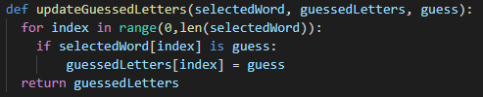
Creating the 1st of 3 functions
For our guess mechanic we are going to create 3 functions, one to show we have guessed letters correctly, one to look at whether we have already guessed a letter and one to make sure our guesses are valid.
Firstly we check whether we have letters correctly in the word.
We create an indexer that checks the letters in the range of the length of the word from zero (where an array starts) to the length of the selected word.
If the letter at the index matches our guess, we update our display to show the new guessedLetters with the guessed letter displayed!

Slide 8
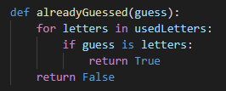
Our 2nd function
Next we need to create e a function that checks whether we have already guessed a letter. We aren’t going to make this function do anything more than that as we’ll use this function in our next function.
So we check in usedLetters for letters. If our guess happens to be any of those letters then we just return true, if not then w return a false.

Slide 9
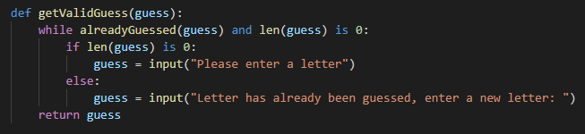
Our final function
Our final function takes alreadyGuessed and also checks that the guess has been filled in. If either case is not “valid” it prompts the user to enter a new guess.
So while the guess is in our alreadyGuessed function and the length of the guess is zero, we then check first if it’s zero and prompt a new input accordingly. If not and it’s that the guess has already been guessed which is the issue, we then prompt for that.

Slide 10
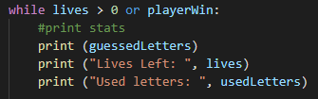
Part 2: The main game logic
The main game logic is where we create the actual game itself, we print our displays, input our guesses, and actually create the game mechanic of winning and losing.
We start with just printing what will be displayed during the game, the display of missing-and-correctly guessed letters, the lives left (we will add lives in a bit) and the list of used letters.
We put these at the top of our while loop which this whole section will be embedded in.

Slide 11
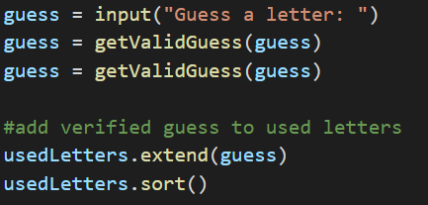
Adding guess input and used letters
We next add our guess input. We then validate our guess straight away to make sure it’s valid.
We extend our guess to our usedLetters list and sort it alphabetically.
Sidenote: Here we use an extend method instead of append like we did with our selectedLetters list. This is because you can add multiple letters in your guess to guess a word and .extend() allows you to add all new guesses to your list instead of append that only adds one letter at a time to the end of your list!

Slide 12
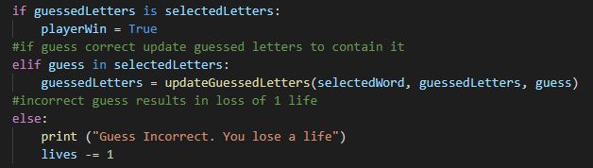
Player winning or losing
If the list of guessed letters matches the list of letters in the selected word, the player wins. It seems way too simple but that’s all it takes!
Else if not all the letters have been guessed yet but a correct guess has been inputted then update the display to show this.
Else (if a guess is incorrect) then make the player lose a life!

Slide 13
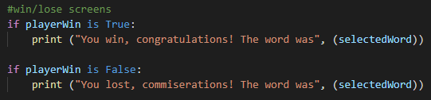
Player winning or losing continued
If playerWin is true, we need to display that, same goes if playerWin is false. At the bottom of our code we’re going to add this code to display this:
These are called if the playerWin state is fulfilled and displays a message with the random word that the player was guessing.

Slide 14
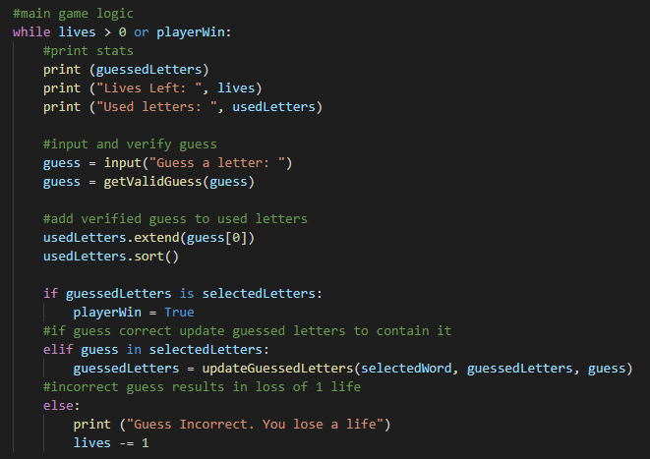
Full logic
That whole section should look like this, the code from the last slide sits underneath:

Slide 15

Part 3: Making the difficulty settings
To add a little flair to our game, we’re going to add a nice little difficulty choice that changes the amount of lives you play with. You could also add different lists of words of different difficulties if you’d like but I chose not too. Start by creating an input with 3 difficulties and make that an integer. Add this above our updateGuessedLetters function.
This input is where we’ll start the game and we just want to know how many lives to give the player.
Make sure that the difficulty input is an integer as we only want 1, 2 or 3!

Slide 16


Making sure the input is valid
We check that the input is within the range we want, so 1, 2 or 3 then print the chosen difficulty if valid.
And as we’ve told the program to make sure the input is an integer, we can perform an exception for a ValueError. This will be triggered if the input type is wrong (such as the input not being an integer) and will re-prompt us for a correct input.

Slide 17
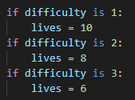
Difficulty and lives
Finally we set the lives depending on the difficulty. These are the lives I’ve chosen but you can choose what yours will be, whether you want them harder or easier.
We will be altering this soon to include some turtle commands that will change how far you start in the animation based on the amount of lives…

Slide 18
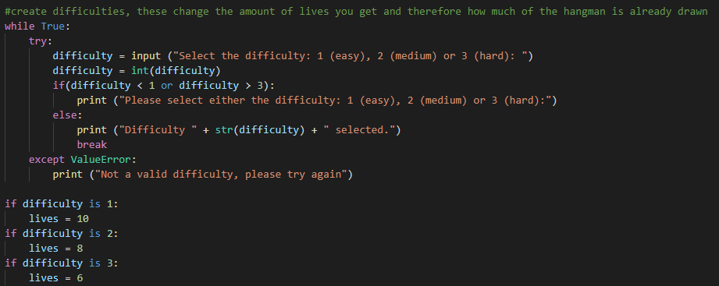
Full difficulty
This is how this section should look:

Slide 19

Part 4: Creating our turtle commands
If you remember we imported turtle into our program when we began. Turtle is python’s inbuilt graphics tool so we’ll be using this to draw our hangman game as you would on pen and paper.
Start by creating variables for our turtle and for our screen, you’ll thank yourself later when it saves you from typing turtle or screen a billion times!
Tip: I coded all my turtle commands in a separate file and split it up into individual moves, this helps in terms of readability and you can then just copy them over once you’re satisfied with the result.

Slide 20
The turtle commands
The commands we’ll be using are mostly very self explanatory.
forward(x) / back(x): Turtle goes forward or back x pixels.
left(x) / right(x): Turtle turns left or right x degrees.
circle(x): Turtle draws a circle of x radius.
penup(): Turtle takes “pen” off the canvas and stops drawing.
pendown(): Turtle puts “pen” back on the canvas and starts drawing.
hideturtle(): Turtle arrow is no longer visible.
setheading(x): Set the angle of the turtle to x (starts facing directly east).
exitonclick(): Closes the window when clicked.

Slide 21
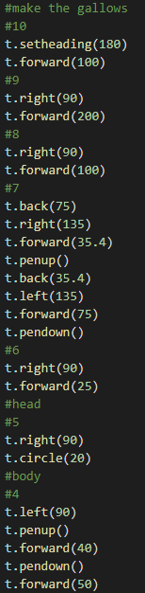
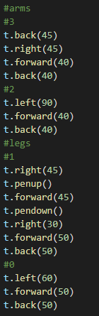
Continuing the turtle commands
The code I wrote for commanding the turtle is quite long and is included in the README in the GitHub repository. Feel free to copy it from there or write your own to draw an original animation!
I created 10 different lines as the max lives I included in my game but if you make your own remember to take that into account to either increase the amount lives or adjust the amount of lines!
Here’s my animation in all it’s glory!

Slide 22
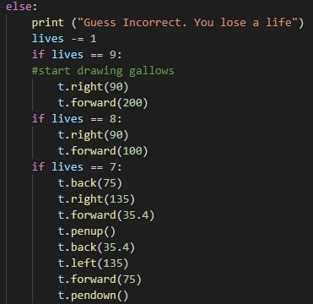
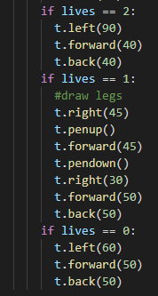
Inputting commands into our program
We’re going to include our turtle commands in our else statement in our game logic, relating each command to an amount of lives. Continue this until you get to “lives == 0”. This is when you draw the last leg and your stickman dies!

Slide 23
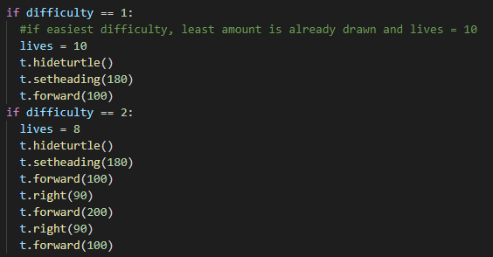
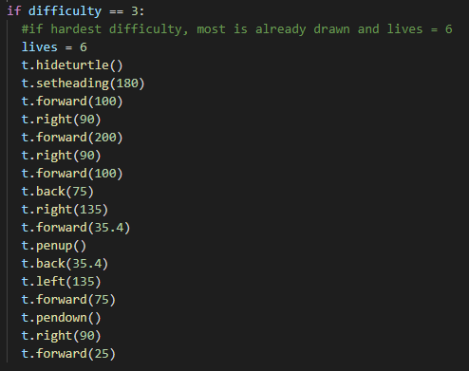
Difficulty settings updated
The harder the difficulty, the less lives and therefore the more of the hangman already drawn. We need to go back and input some commands into our difficulty to make this happen.
(Feel free to copy from repo)

Slide 24
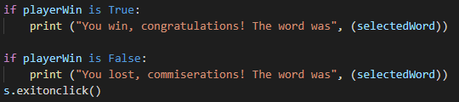
Exit on click
And finally all we need to do is add s.exitonclick() to the very end of our code so that our turtle screen doesn’t close as soon as the game is finished.
This concludes the coding for our game!

Slide 25


Part 5: Playing the game
You should begin by the turtle screen opening and being prompted in your terminal like this:
After you’ve chosen your difficulty, your turtle may begin drawing your gallows if you’ve stared on a harder difficulty and you’ll be asked to guess a letter after being shown your display, lives and used letters.
Start: After a couple guesses:
After a couple of guesses, you’re display should be updating (if you’re getting any letters correct), your used letters should be updating and lives going down (if you’re getting any letters wrong)

Slide 26
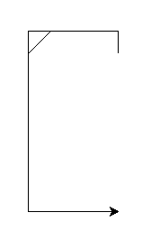

Congratulations on making hangman!
This is what it will look like upon successfully guessing the random word!
Thanks for taking part and I hope you enjoyed making hangman in python using turtle graphics!

